Slide 1
Whiskey Trends
By Bryce Bowles,
Sean McCarty,
Drew Stachowiak

Slide 2
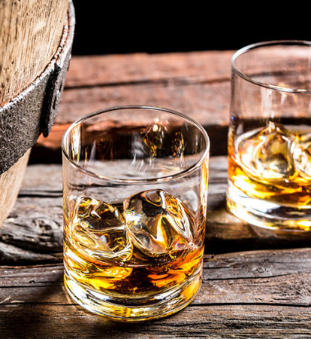
Whiskeys at a Glance
Whiskey Name: Name of each Whiskey as labeled on each bottle
Cask: Type of barrel used to age the whiskey or create a finish.
Distillery: Name of the company that distilled (created) the whiskey
Bottler: Name of the company that bottles the whiskey and distributes/sells the finished product (There are 9 Distinct Bottlers)
Rating: Average rating provided by user reviews on a 100-point scale
Reviews: Number of reviews for each Whiskey
Strength: Percent amount of alcohol contained in the bottle
Age: Length of time the youngest whiskey was aged within a barrel
US Currency: Price of the bottle

Slide 3
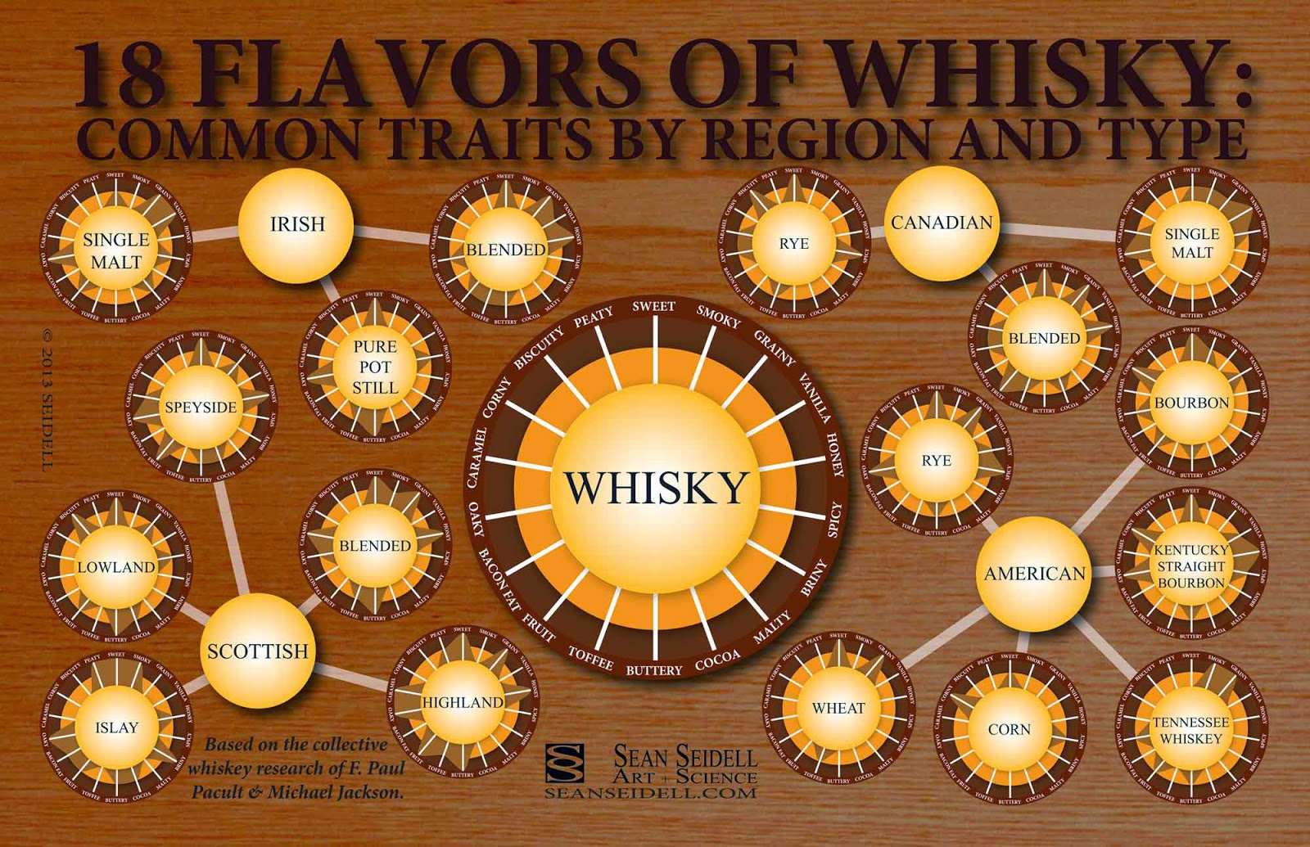
Categories
Single Malt - whisky must have been produced by one distillery one and one grain (malted barley) and must also be aged for at least three years in oak casks. (laws vary)
“Blend” or “Blended”- product of blending different types of whiskeys
Single Grain - are often made from wheat, corn, or a blend of the two - the grain does not need to be malted
Corn - American made from a mash of at least 80 percent corn
Bourbon - a barrel-aged distilled spirit made primarily from corn
Spirit - a combination of neutral grain spirit and whiskey, consisting of at least 5% whiskey and no more than 20% straight whiskey (a category of American whiskey aged at least two years, among other requirements)
Rye - American, must be distilled from at least 51 percent rye grain

Slide 4
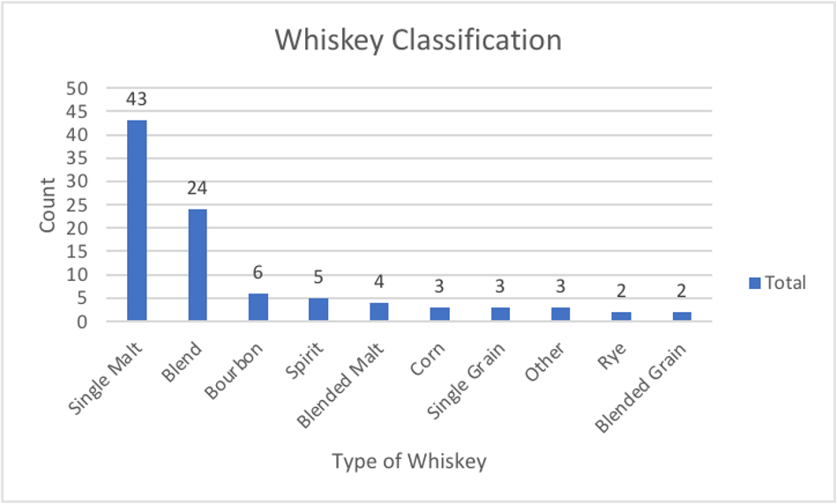
Qualities of the Worst Whiskies
Lowest legal proof to be considered "Whiskey"
Generally cheap
Aged for small amounts of time, if any
Casks are usually American White Oak
Distilling technique has a lot of variation
 | Rating | Size | Strength | Age | Price
Rating | 1 | 0.096 | -0.094 | -0.057 | 0.127
Size | 0.096 | 1 | -0.031 | -0.074 | 0.046
Strength | -0.094 | -0.031 | 1 | 0.028 | 0.350
Age | -0.057 | -0.074 | 0.028 | 1 | -0.007
Price | 0.127 | 0.046 | 0.350 | -0.007 | 1

Slide 5
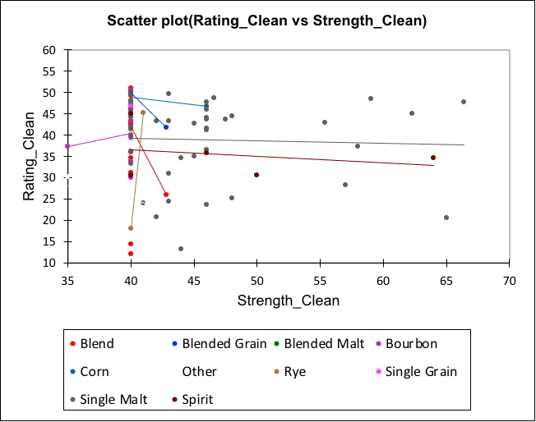
Worst Proof We've Got
The Alcohol By Volume (ABV) of the worst whiskies generally fall around the 40% mark as this is the legal minimum for these spirits to be classified as "Whiskey".
The types of whiskies vary quite a bit, there is however a sizable cluster of single malt whiskies on the far right.
Single Malt has a shallow negative relationship.
Blends have a steep negative relationship. Mostly around the 40% mark.

Slide 6
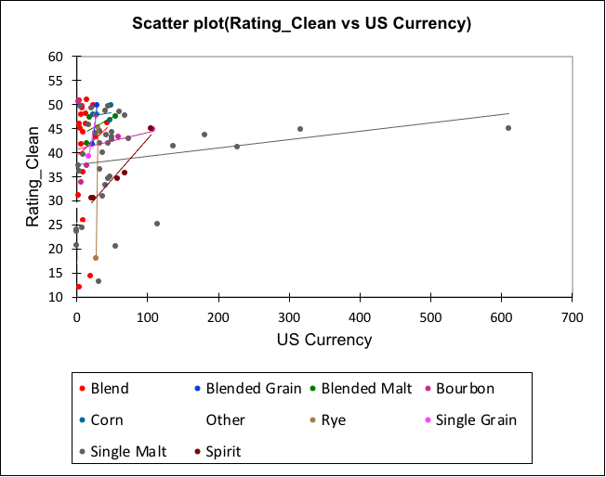
Got Anything Cheap?
The price of these whiskies are generally going to be low. There are outliers such as that Single Malt to the right, but it also scored a 45 rating.
Most of these whiskies trend towards the upper left corner and are mostly under $100

Slide 7
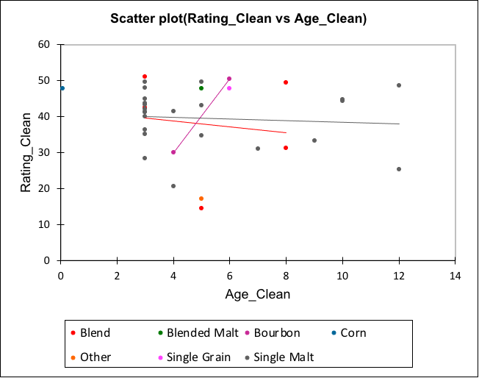
Not Old Enough!
Aging a whiskey is meant to expel the harsher tones of the taste while infusing the barrels' essence into the profile.
Most of these whiskies do not have age statements. The ones that do have nothing to brag about.
Single Malts have the longest aging in barrels at only 12 years.
There is one spirit with an age statement of <30 days.

Slide 8
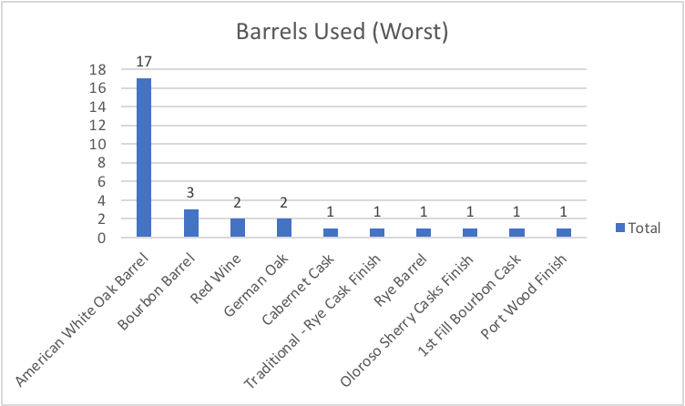
Barrels of Fun
The barrels whiskey is aged in influence the flavors of the whiskey.
The most popular whiskey to age in is American White Oak. This wood is required for whiskies to be classified as "bourbon".

Slide 9
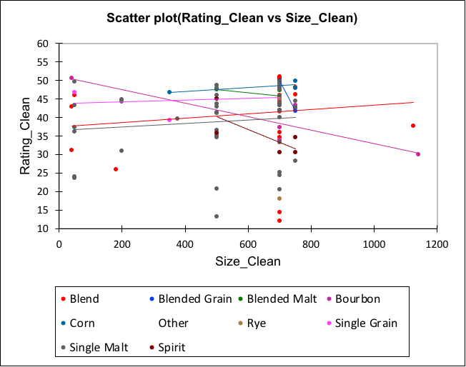
Too Much or Not Enough?
The size of product does not seem to have too big of an influence on the rating.
People enjoy a whiskey if there is more to go around.

Slide 10
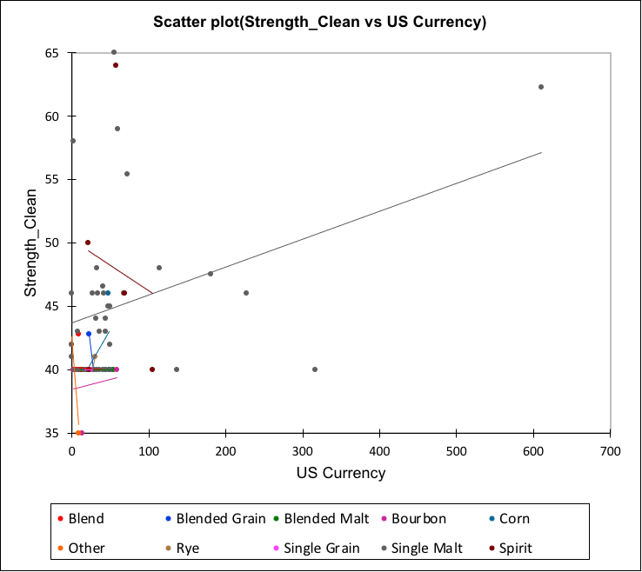
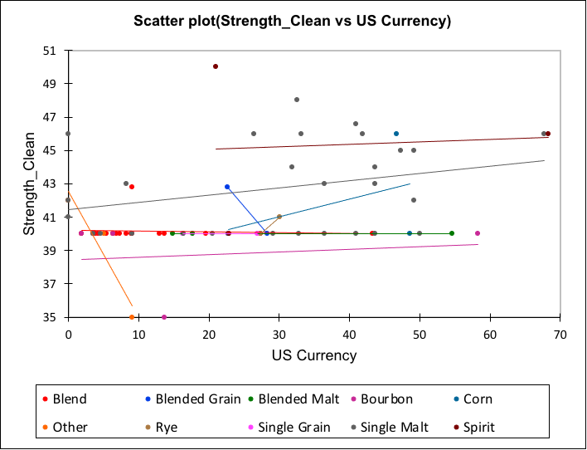
Strength's Influence on Price
Strength/Price SCA with Outliers
Strength/Price SCA without Outliers

Slide 11
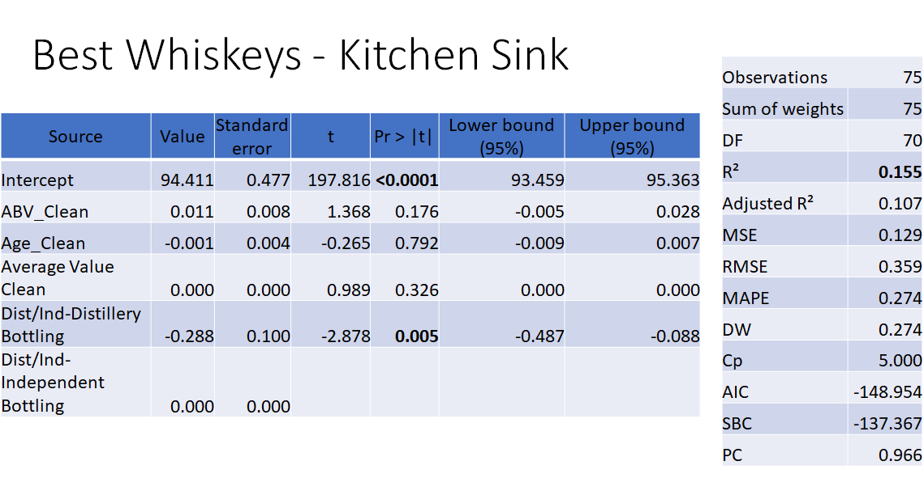

Slide 12
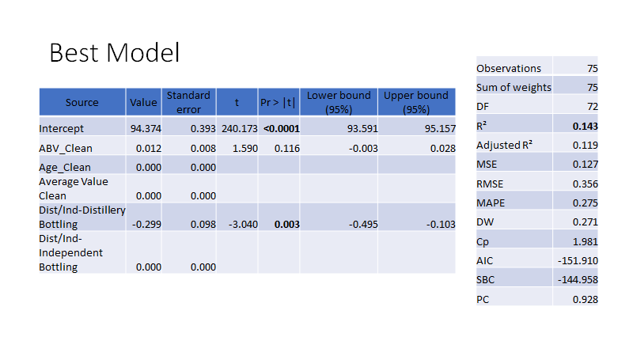

Slide 13
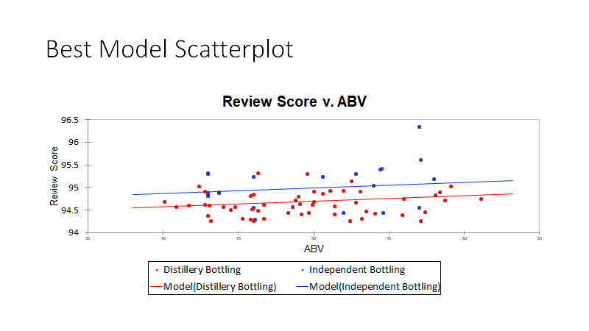

Slide 14
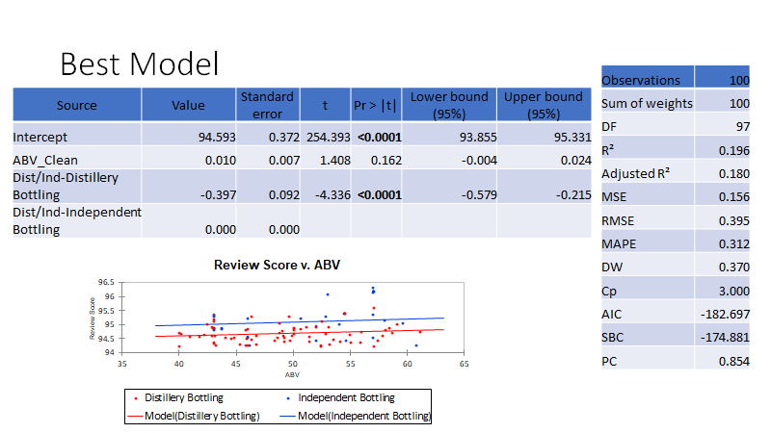

Slide 15
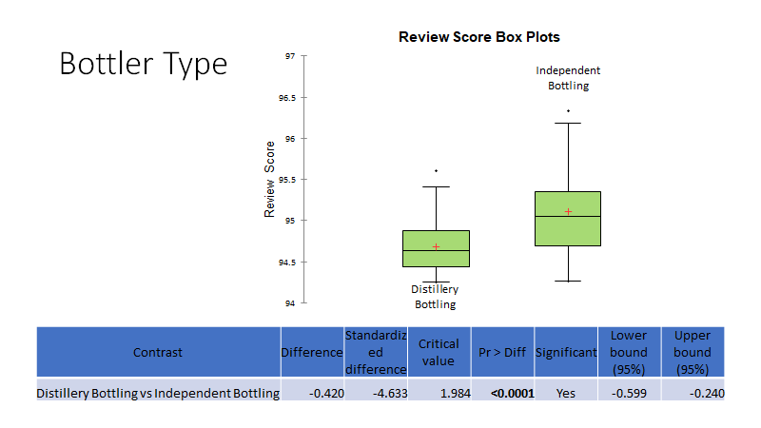

Slide 16
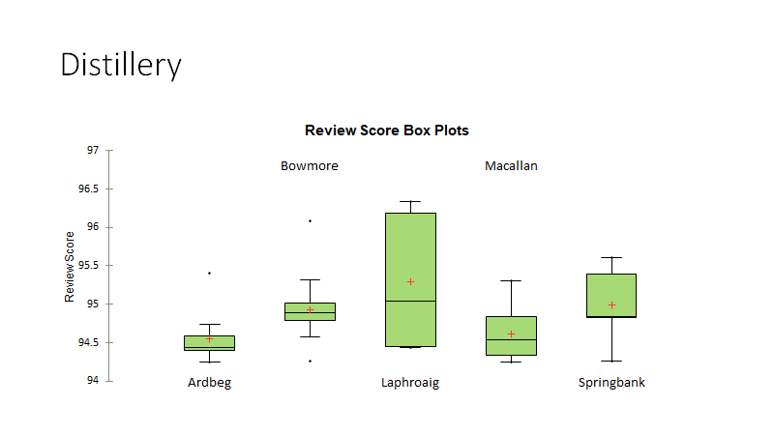

Slide 17
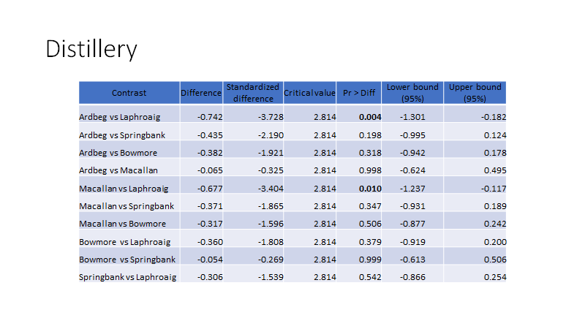

Slide 18
Logistic Regression Model Predicting Best / Worst
Summary Statistics
How the data was partitioned
Training Set
Validation Set
Variable | Categories | Frequencies | %
Best or Worst (ID) | Best | 86 | 58.904
 | Worst | 60 | 41.096
Variable | Categories | Frequencies | %
Best or Worst (ID) | Best | 11 | 55.000
 | Worst | 9 | 45.000
Variable | Categories | Frequencies | %
 | Single Malt | 124 | 84.932
Category | Blend | 5 | 3.425
 | Spirit | 4 | 2.740
 | Bourbon | 3 | 2.055
 | Single Grain | 3 | 2.055
 | Blended Malt | 2 | 1.370
 | Corn | 2 | 1.370
 | Rye | 2 | 1.370
 | Blended Grain | 1 | 0.685
Variable | Categories | Frequencies | %
 | Single Malt | 17 | 85.000
 | Bourbon | 2 | 10.000
 | Spirit | 1 | 5.000
Category | Blend | 0 | 0.000
 | Blended Grain | 0 | 0.000
 | Blended Malt | 0 | 0.000
 | Corn | 0 | 0.000
 | Rye | 0 | 0.000
 | Single Grain | 0 | 0.000

Slide 19
Regression of variable Best or Worst (ID):
Correlation Matrix
Goodness of fit statistics
Variables | Strength_Clean | Age_Clean | US Currency
Strength_Clean | 1.000 | 0.157 | 0.239
Age_Clean | 0.157 | 1.000 | 0.278
US Currency | 0.239 | 0.278 | 1.000
Statistic | Independent | Full
Observations | 146 | 146
Sum of weights | 146.000 | 146.000
DF | 145 | 134
-2 Log(Likelihood) | 197.744 | 26.822
R²(McFadden) | 0.000 | 0.864
R²(Cox and Snell) | 0.000 | 0.690
R²(Nagelkerke) | 0.000 | 0.930
AIC | 199.744 | 50.822
SBC | 202.728 | 86.625
Iterations | 0 | 34

Slide 20
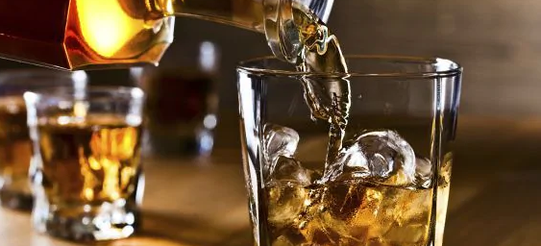
Model Traits (Variable Best or Worst)
Test of the null hypothesis H0: Y=0.411
Does this model do anything for us when predicting the response variable? Yes
“Lack of fit test” - Are more variables needed for this model? Possibly
Statistic | Chi-square | DF | Pr > Chi²
Hosmer-Lemeshow Statistic | 21.218 | 8 | 0.007
Statistic | DF | Chi-square | Pr > Chi²
-2 Log(Likelihood) | 11 | 170.922 | < 0.0001
Score | 11 | 86.640 | < 0.0001
Wald | 11 | 17.972 | 0.082
Notes:
Hosmer-Lemeshow test:
Predicted response compared to the actual response in the data.
I think this model is good, does the data disagree and does the model need more?
“Lack of fit test”

Slide 21
Variables
Type II analysis
Significant effects
on Best or Worst
Source | DF | Chi-square (Wald) | Pr > Wald | Chi-square (LR) | Pr > LR
Strength_Clean | 1 | 0.073 | 0.788 | 23.698 | < 0.0001
Age_Clean | 1 | 11.329 | 0.001 | 57.154 | < 0.0001
US Currency | 1 | 12.982 | 0.000 | 89.137 | < 0.0001
Category | 8 | 8.153 | 0.419 | 41.562 | < 0.0001
Model parameters (Variable Best or Worst (ID)):
Source | Value | Standard error | Wald Chi-Square | Pr > Chi²
Intercept | 13.722 | 4.294 | 10.213 | 0.001
Strength_Clean | -0.014 | 0.053 | 0.073 | 0.788
Age_Clean | -0.242 | 0.072 | 11.329 | 0.001
US Currency | -0.001 | 0.000 | 12.982 | 0.000
Category-Blend | 0.000 | 0.000
Category-Blended Grain | -5.722 | 3.623 | 2.494 | 0.114
Category-Blended Malt | -4.882 | 3.286 | 2.207 | 0.137
Category-Bourbon | -5.280 | 3.348 | 2.487 | 0.115
Category-Corn | -5.203 | 3.375 | 2.377 | 0.123
Category-Rye | -5.239 | 3.361 | 2.430 | 0.119
Category-Single Grain | 0.010 | 3.239 | 0.000 | 0.998
Category-Single Malt | -5.825 | 2.729 | 4.555 | 0.033
Category-Spirit | -4.545 | 3.324 | 1.869 | 0.172
Notes:
Model Parameters
Can see how other categories compare to the baseline “Category-Blend”
which variable traits are more likely to be best or worst. Sigle Malt is showing to more likely be best and blended grain is more likely to be worst.

Slide 22
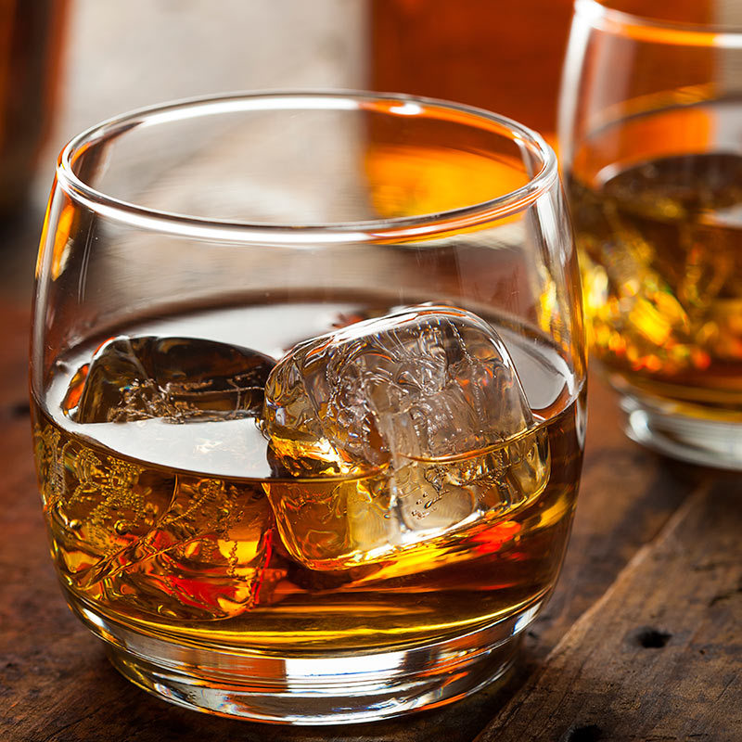
Confusion Matrix
Classification table for the training sample
from \ to | Best | Worst | Total | % correct
Best | 80 | 6 | 86 | 93.02%
Worst | 1 | 59 | 60 | 98.33%
Total | 81 | 65 | 146 | 95.21%
Classification table for the validation sample
from \ to | Best | Worst | Total | % correct
Best | 9 | 2 | 11 | 81.82%
Worst | 1 | 8 | 9 | 88.89%
Total | 10 | 10 | 20 | 85.00%
Notes:
86 best…
Results did not vary much from each training and validation sample sizes. This could be due to
https://www.google.com/url?sa=i&url=https%3A%2F%2Fwww.candlescience.com%2Ffragrance%2Fwhiskey-fragrance-oil&psig=AOvVaw1R7UXUEfioaNAbHTNgkynA&ust=1605738812758000&source=images&cd=vfe&ved=0CAIQjRxqFwoTCODs_rzRiu0CFQAAAAAdAAAAABAD

Slide 23

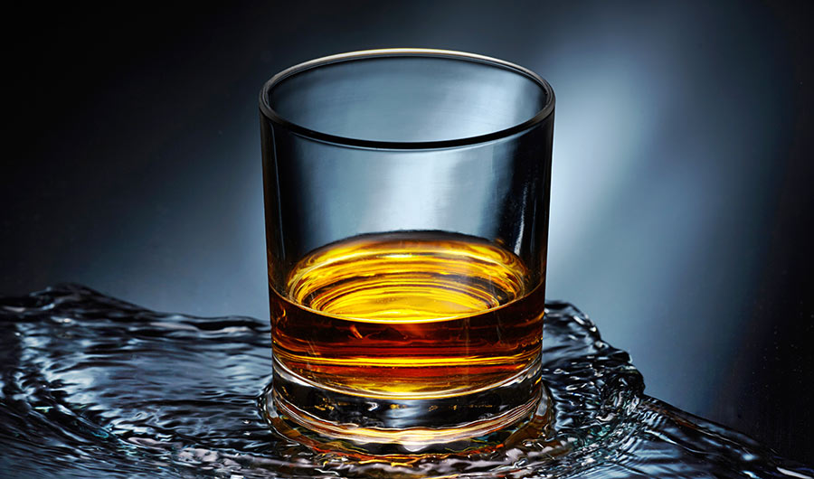
Conclusion
Whiskey is complicated
People are complicated
Whiskey is best enjoyed how you enjoy it

Slide 24
Acknowledgements
https://www.whiskybase.com/whiskies - Dataset
https://insidescience.org/news/not-so-neat-why-you-should-add-water-your-whiskey - Picture
https://www.google.com/url?sa=i&url=https%3A%2F%2Ffood.ndtv.com%2Ffood-drinks%2F6-different-types-of-whiskeys-a-whiskey-or-a-whisky-lover-should-know-1744958&psig=AOvVaw1R7UXUEfioaNAbHTNgkynA&ust=1605738812758000&source=images&cd=vfe&ved=0CAIQjRxqFwoTCODs_rzRiu0CFQAAAAAdAAAAABAJ – Picture
https://www.google.com/url?sa=i&url=https%3A%2F%2Fwww.candlescience.com%2Ffragrance%2Fwhiskey-fragrance-oil&psig=AOvVaw1R7UXUEfioaNAbHTNgkynA&ust=1605738812758000&source=images&cd=vfe&ved=0CAIQjRxqFwoTCODs_rzRiu0CFQAAAAAdAAAAABAD

